Slide 1
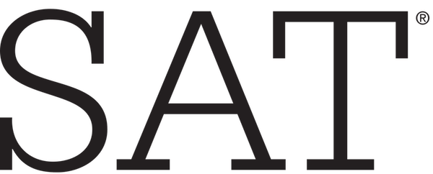

Understanding the causes of change in participation for SAT and ACT exams from 2017 to 2018
By: Eugene, Darion, Asyraf

Slide 2
Dataset Details
State name
SAT:
Participation Rate
Evidence-Based Reading & Writing
Math
Total Score
ACT:
Participation Rate
Reading
English
Math
Science
Composite Score
Notes:
To include the fact that the datasets are spanning across 2017 and 2018.
50 states, plus the District of Columbia, for a total of 51 rows of data.

Slide 3
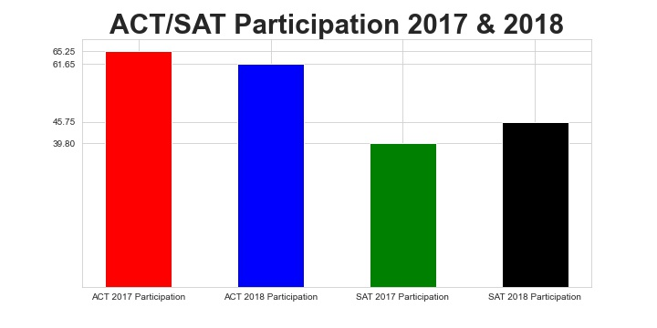
Let’s look at the participation between 2017 and 2018
ACT Participation Dropped from 2017 to 2018 SAT Participation Increased from 2017 to 2018

Slide 4
At a glance, what does it tell us?
At a national level, there is an increasing shift in SAT as compared to ACT
Policy change ?
SAT assessment change?
Admission requirement change?
There might be a correlation between the change in one as compared to the other (inversely correlated)

Slide 5
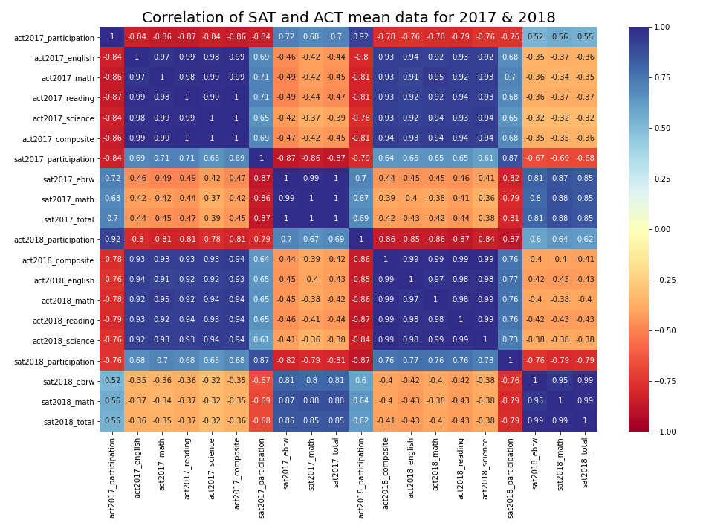
Correlation between
Notes:
Heatmap for correlation in the data

Slide 6
Correlation of the Data
Based on the heatmap from the previous slide, the following are our findings about the data:
There is a negative correlation between the participation of ACT and SAT in both years. Not a big incentive to take both!
There is a negative correlation between the SAT participation and SAT total mean score in both years. When the participation rate increase, the mean score tends to decrease.
There is a positive correlation between the SAT total mean score and its sub-tests mean score. This is due to the sub-tests are being part of its total score.
Notes:
3 points found from the heatmap.
Negative correlation between ACT and SAT participation.
Negative correlation between SAT participation and SAT total mean score.
Positive correlation between SAT total mean score and its sub-test.
Based on the heatmap from the previous slide, the following are our findings about the data:
There is a negative correlation between the participation of ACT and SAT in both years. This might be the case whereby, students who took up SAT do not take ACT in the same year, vice versa.
There is a negative correlation between the SAT participation and SAT total mean score in both years. When the participation rate increase, the mean score tends to decrease. This might be case whereby, when the state fund the students for full participation for the test, not all students are prepared for the test.
There is a positive correlation between the SAT total mean score and its sub-tests mean score. This is due to the sub-tests are being part of its total score.

Slide 7
In order to understand at a deeper level...
Looking at a more micro aggregation of the data (state level)
Identify trends that had a significant change in participation rate (>10%)
Identify state of interest. Highest and lowest as comparison

Slide 8
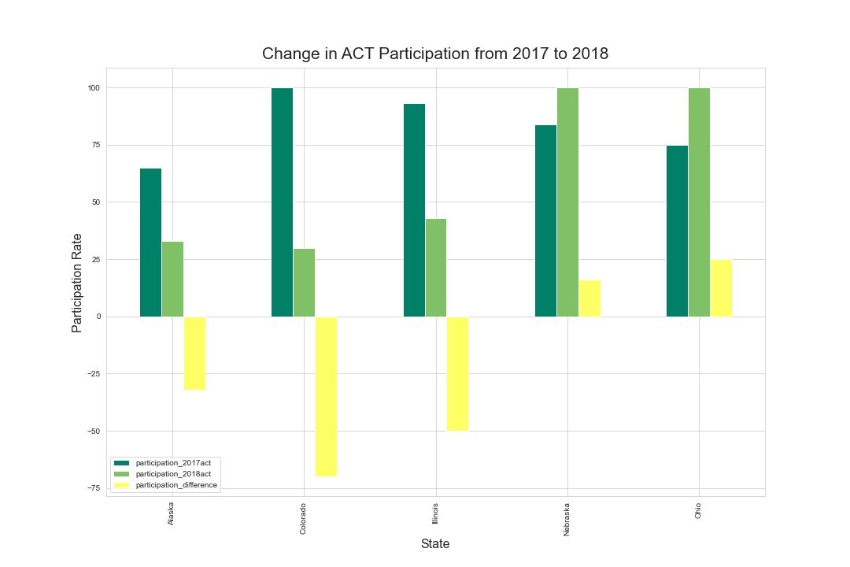
States with >10% change in ACT participation
Colorado and Illinois have the biggest change, 70% and 50% declines respectively.
Ohio increased by 25%

Slide 9
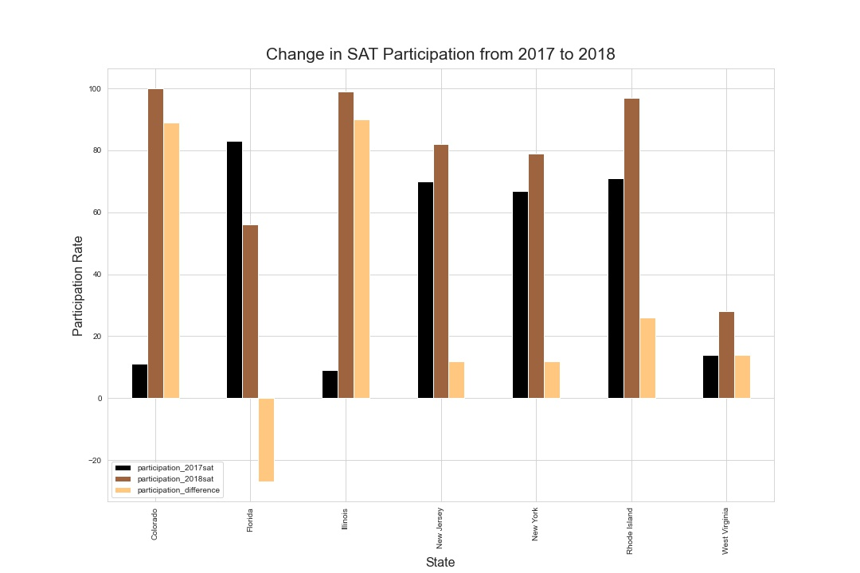
States with >10% change in SAT participation
Again, Colorado and Illinois produced the biggest change of 89% and 90% respectively.

Slide 10
What changed in Colorado & Illinois?
Policy change, making it mandatory for all students to sit for SAT in 2017.
Accounted for the drastic shift from the more popular ACT to SAT.
Students were not made to choose between the two tests.
Sit for ACT as an additional test (only for those who are confident of doing well)
Notes:
https://www.washingtonpost.com/education/2018/10/23/sat-reclaims-title-most-widely-used-college-admission-test/

Slide 11
What about Ohio?
Introduced funding for tests, making it free for students to sit for either ACT or SAT.
Accounted for the change to full participation for ACT.
Increase in SAT participation as well
Incentive for students to sit for either or both tests
Further increase in ACT participation due to familiarity (switching will require administrative and syllabus change)
Notes:
https://www.dispatch.com/news/20170228/ohio-schools-must-now-give-act-or-sat-to-all-juniors
https://newsroom.collegeboard.org/more-2-million-students-class-2018-took-sat-highest-ever
From the perspective of ACT, Ohio showed an increase in ACT participation, from 75% in 2017 to 100% in the subsequent year. In fact, the Class of 2018 was the first where the state paid for all students to take the exam[5].
This change, which became a state law in 2014, has been attributed to the state picking up the $5.25 million tab for each student to take one of the tests once[6].
ACT was subsequently the overwhelming preference of college-bound students.
However, a common consequence observed for states pushing for 100% participation is a drop in state-wide mean scores.
Ohio's declines were larger than that of the national benchmarks for ACT, but taking into consideration a significant increase in the number of students taking the test (including academically struggling students who may not have taken it otherwise) it is understandable that Ohio’s performance would drop[7].
https://www.daytondailynews.com/news/historically-low-act-scores-red-flag-for-our-country/djfx9Urp719WyEaMfykyxL/

Slide 12
What lessons can be drawn from these examples?
State policies will go a long way to increase participation of exams
Incentivise students to participate (making it free)
Mandating the students to participate

Slide 13
Can we replicate it to other states?
As you can see, crafting policies to boost participation works!
Many Ivy League universities use standardised test for their admission process which gives further incentive to move towards having these tests accessible to students.
Having more students participate for standardised tests also allows you to gauge the quality of the students amongst their peers.
Ultimately, we want education to flourish!

Slide 14
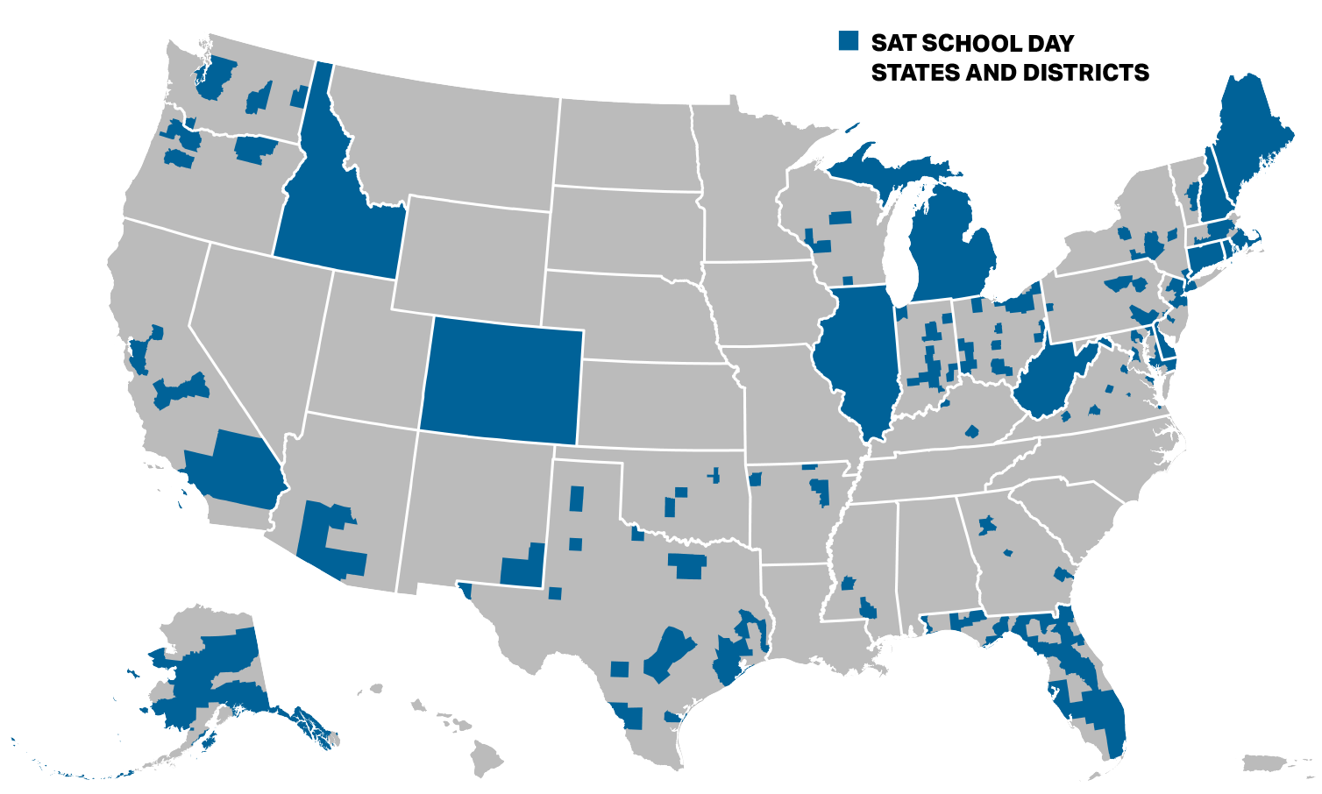
School SAT Day Program
10 states receiving full support in 2018: - Take test on a weekday. - Cost fully covered by state.
22 states receiving district/school level support for administering SAT.
Notes:
https://collegereadiness.collegeboard.org/sat/k12-educators/sat-school-day/about
Those 95% to 100% participation rates for SAT are definitely not voluntary. The School SAT Day program by college board provides a means for SAT to be administered on a normal school day (i.e. weekday, not weekend).
Convenience: can take directly in school, not some test-center on a weekend. Comfort: familiar school environment to mitigate student anxiety. Confidence: Training plan and materials provided by 3rd party education companies like Khan Academy and Testive.
10 states (Colorado, Connecticut, Delaware, Idaho, Illinois, Maine, Michigan, New Hampshire, Rhode Island, and West Virginia) and the District of Columbia covered the cost of SAT for all their public school students, via School SAT Day. They do the test on a school day, not the weekend.
22 states ['Washington','Oregon','California','Alaska','Arizona','New Mexico','Texas','Oklahoma','Arkansas', 'Florida', 'Georgia','Virginia','Kentucky','Indiana','Ohio', 'Pennsylvania','New Jersey','Maryland', 'Massachusetts','Vermont','Wisconsin', 'New York'] have partial support.
Iowa not included here!

Slide 15
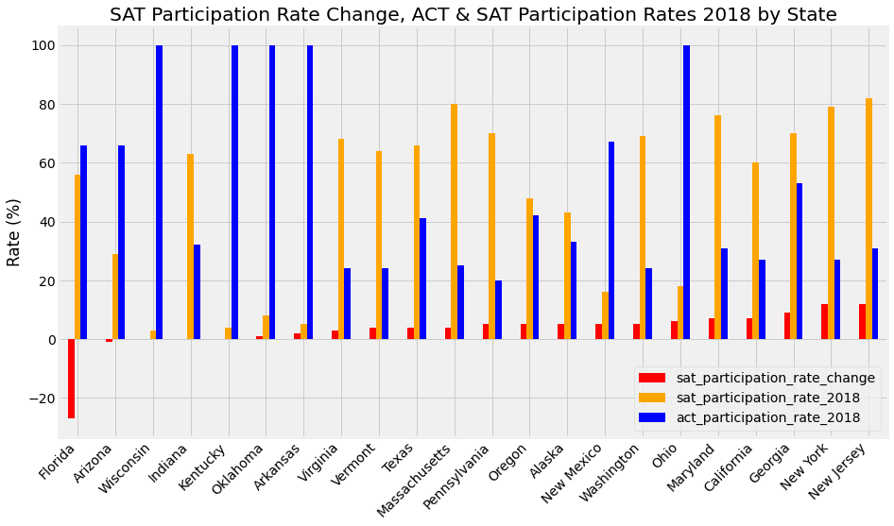
Effect of School SAT Day partial support
Varying degrees of improvement to SAT participation rate.
Notes:
Bar plot show the participation rate details of the 22 states that received partial support from School Sat Day, meaning only district/school level support, not state-wide implementation.
Red bar shows the year-on-year improvement to the SAT participation rate (2017 to 2018). Bar chart is sorted by ascending order of rate-change, lowest by Florida (-27%) on left, to highest by New Jersey on right with 12% improvement. Emphasize the red bar being evidence the Iowa might stand a chance to have improvement if starting off with at least partial support from School SAT Day. Full state-wide support would be best.
Partial Support does help to a certain extend in increasing SAT participation for most states (but there might be other factors that dampen any potential improvement.)
Next, we bring our focus to one of the states receiving partial support here, and that is Alaska. From the bar-chart
SAT National participation rate 2018: 45.0%, ACT at 61.6%, Alaska is below those benchmarks.

Slide 16
Noteworthy Considerations.
As the coronavirus continues to hit us, many colleges have waived ACT and SAT requirements in their admission process. As the trend continues to occur, it is noteworthy to also consider the implications on whether the recommendations made will be effective in the future.
We look at the case of Alaska and the trend of dropping ACT/SAT requirements for colleges

Slide 17
ACT and SAT in Alaska
Alaska's participation rates in both ACT and SAT remain below 50% in 2018, despite having received partial support from the SAT School Day program.
A state law requiring college or career readiness tests for high school students to graduate with diplomas has expired in mid-2016. Previously, SAT, ACT or WorkKeys were available options.
3 out of 5 universities in Alaska have open-admission policy, i.e. SAT/ACT results are not required.
Fast-forward till present day, University of Alaska Fairbanks has extended their SAT/ACT requirements waiver for undergraduate admission through the fall 2021 semester, in an effort to remove barriers for prospective students who want to go to college, but may not have access to testing in their local communities due to COVID-19 pandemic closure of test centers.
Extending more support to Alaska might not help if the universities are predominantly open-admissions.
Notes:
Previously, the state paid about $525,000 a year for every student to take one of the 3 stipulated tests (SAT, ACT, or WorkKeys).
https://www.adn.com/alaska-news/education/2016/06/30/students-no-longer-need-national-tests-to-graduate/

Slide 18
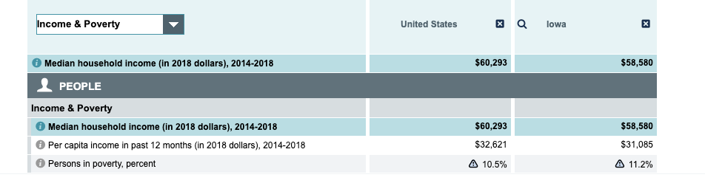
SAT in Iowa
In Iowa, the SAT participation is one of the lowest, having only 2% participation in 2017 and 3% participation in 2018. Its ACT participation is 67% in 2017 and 68% in 2018.
Based on additional outside research, in Iowa, students currently do not have subsidy for SAT and ACT. To enter the university of Iowa, the applicant will require a ACT composite score of 26, or a SAT total of 1230.
Based on the table below, Iowa's median household income is lower than the national's median household, subsidies might be able to help some students.
Notes:
Iowa is definitely among bottom 10 states in terms of SAT participation rate for both years.
Data from Iowa: https://data.census.gov/cedsci/profile?g=0400000US19

Slide 19
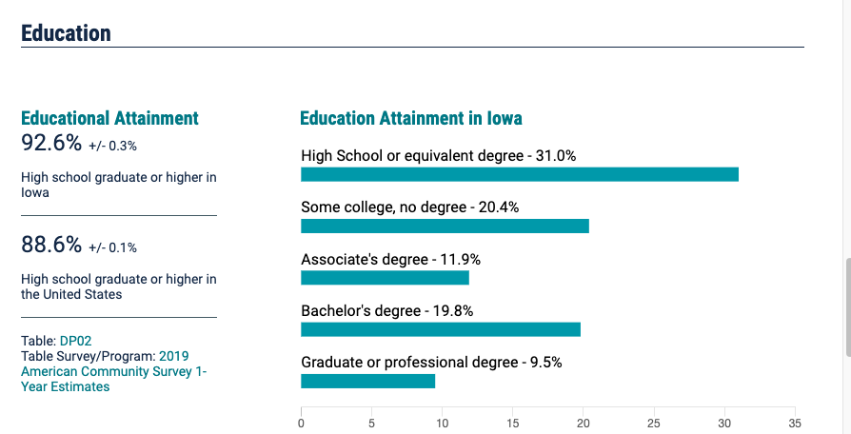
SAT in Iowa
A recommendation will be working with the state of Iowa and implementing on SAT Day in the state. As SAT Day is on a school day, it can encourage students to participate. It does not cost the student and students might treat it as part of the curriculum.
Educational attainment for high school or higher in Iowa is 92.6%, which is higher than the national level. However, out of 92.6%, 31% is high school. Implementing SAT day might even promote more students to enter college after high school, as SAT is one of a requirements.
Notes:
SAT day implentation.
The benefits are promoted students to attend SAT on school day. Help to promote students to enter college, so as to increase education attainment in college or even degree level.
Source from SAT https://data.census.gov/cedsci/profile?g=0400000US19
SAT School Day Benefits for Low-Income Students Low-income students participating in SAT School Day are eligible for the following benefits: Free Tests and Feedback
2 free Saturday SATs, with or without the essay
6 free SAT Subject Tests
2 free Question-and-Answer Service (QAS) or Student Answer Service (SAS) reports
Free College Benefits
Unlimited score reports to send to colleges
Waived application fees at participating colleges

Slide 20
Conclusion...
Changes to participation can be enforced via policy change or statewide support/funding
Replicating over other states can work in achieving the desired outcome of participation
Full participation as an act to make education accessible
Important to also understand the changing admission college requirement in light of recent times
Ultimately, must find a common ground between policy and college entry requirement
Notes:
Test participation rate is significantly influenced by state policy and legislation.
Participation rate for a test is negatively correlated with test scores, i.e. for states where participation rate is improved to 100%, the state-wide score means would subsequently drop by a certain degree.
This is likely due to the new presence of weaker students in the test-taking cohort which would previously likely contain only students who have made plans and preparation to take the test for college admission purposes.

